Slide 2
2 Peter 3:3-4 Knowing this first, that there shall come in the last days scoffers, walking after their own lusts, 4 And saying, Where is the promise of his coming? for since the fathers fell asleep, all things continue as they were from the beginning of the creation.

Slide 3
Colossians 2:13-17 And you, being dead in your sins and the uncircumcision of your flesh, hath he quickened together with him, having forgiven you all trespasses; 14 Blotting out the handwriting of ordinances that was against us, which was contrary to us, and took it out of the way, nailing it to his cross; 15 And having spoiled principalities and powers, he made a shew of them openly, triumphing over them in it. 16 Let no man therefore judge you in meat, or in drink, or in respect of an holyday, or of the new moon, or of the sabbath days: 17 Which are a shadow of things to come; but the body is of Christ.

Slide 4
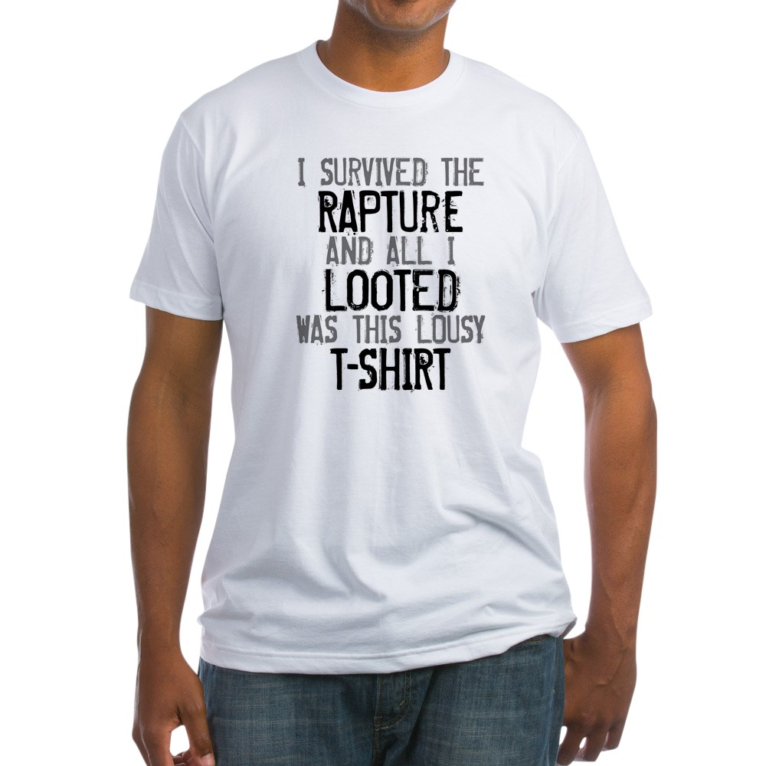

Slide 5
Philippians 3:20 For our conversation is in heaven; from whence also we look for the Saviour, the Lord Jesus Christ:
Colossians 3:1-4 If ye then be risen with Christ, seek those things which are above, where Christ sitteth on the right hand of God. 2 Set your affection on things above, not on things on the earth. 3 For ye are dead, and your life is hid with Christ in God. 4 When Christ, who is our life, shall appear, then shall ye also appear with him in glory.

Slide 6
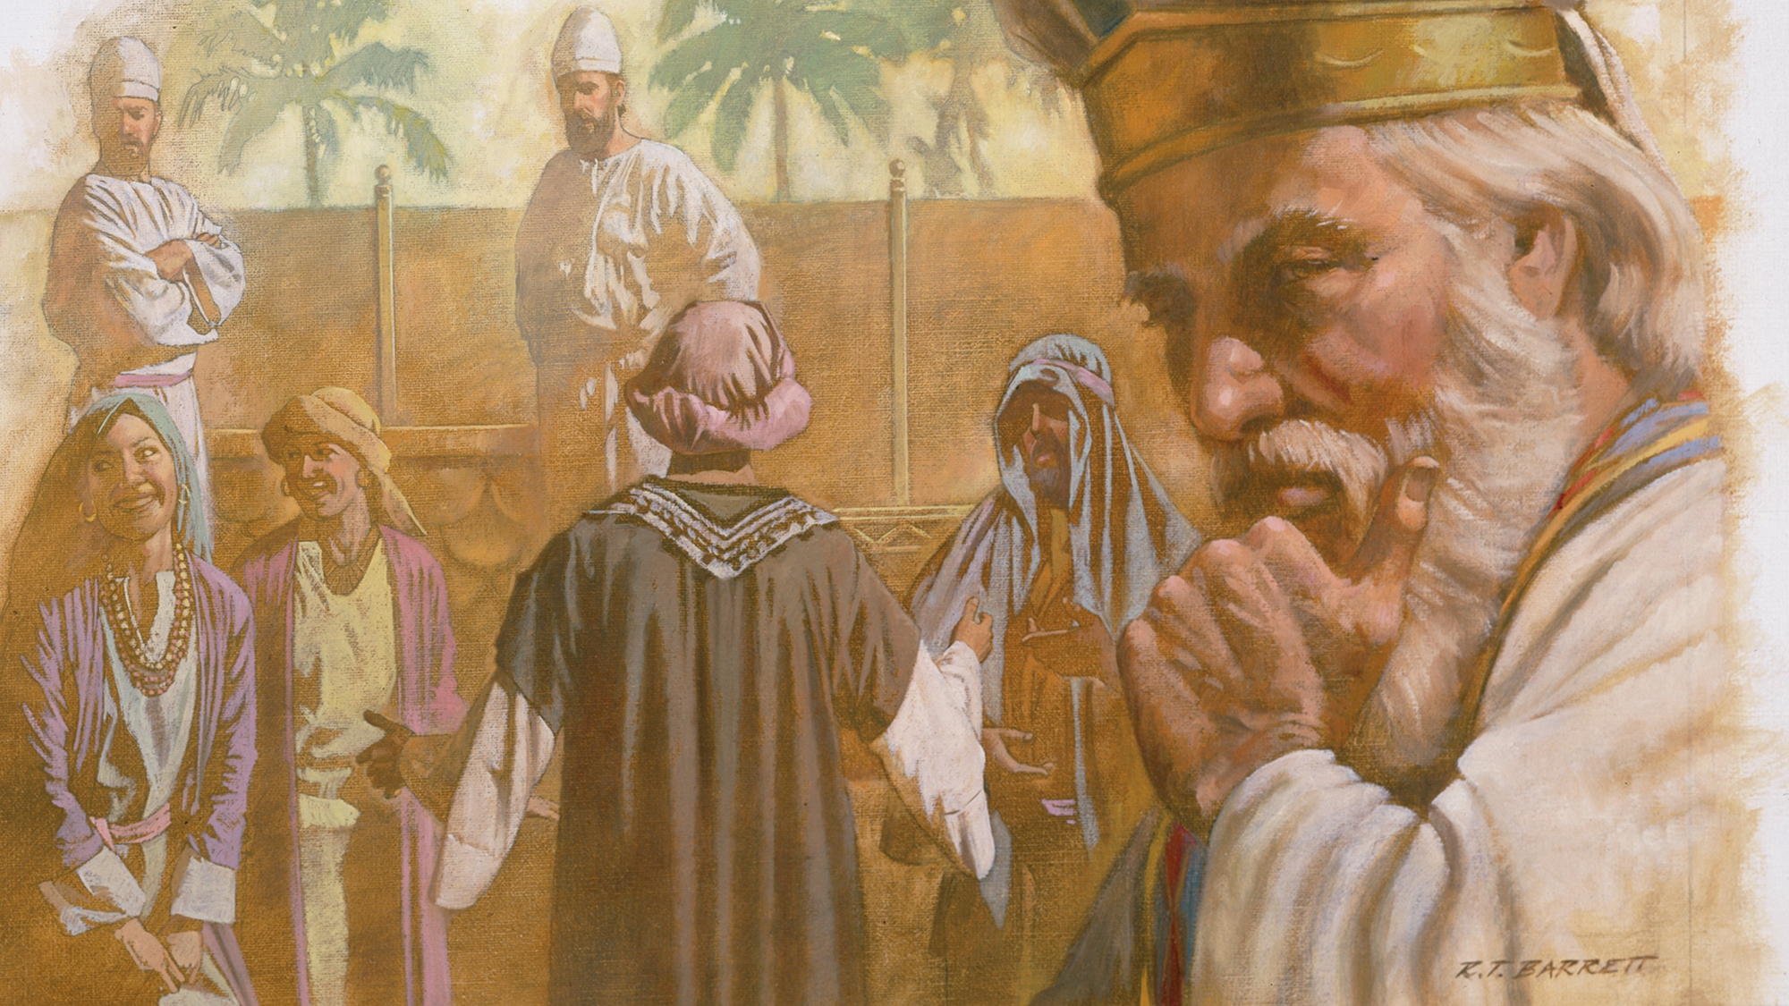
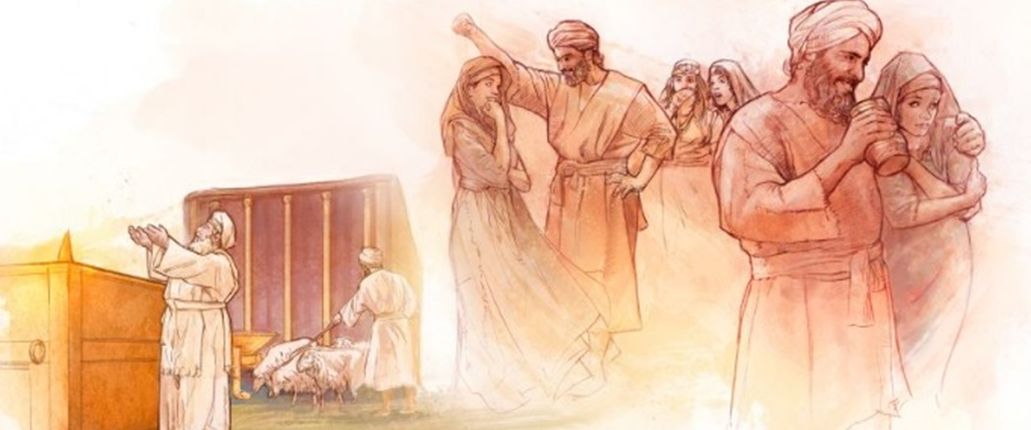
A Failed Family.

Slide 7
God is now replacing their leadership.
Romans 8:16-17 The Spirit itself beareth witness with our spirit, that we are the children of God: 17 And if children, then heirs; heirs of God, and joint-heirs with Christ; if so be that we suffer with him, that we may be also glorified together.
1 Corinthians 3:15 If any man's work shall be burned, he shall suffer loss: but he himself shall be saved; yet so as by fire.

Slide 8
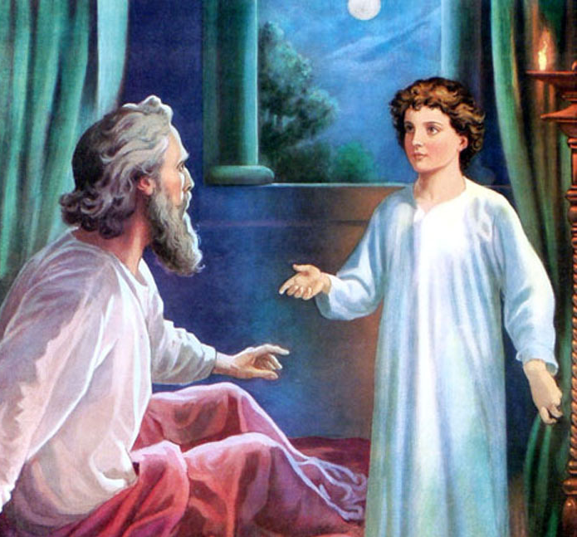
HEARING GOD
RECEIVING GOD’S WORD

Slide 9
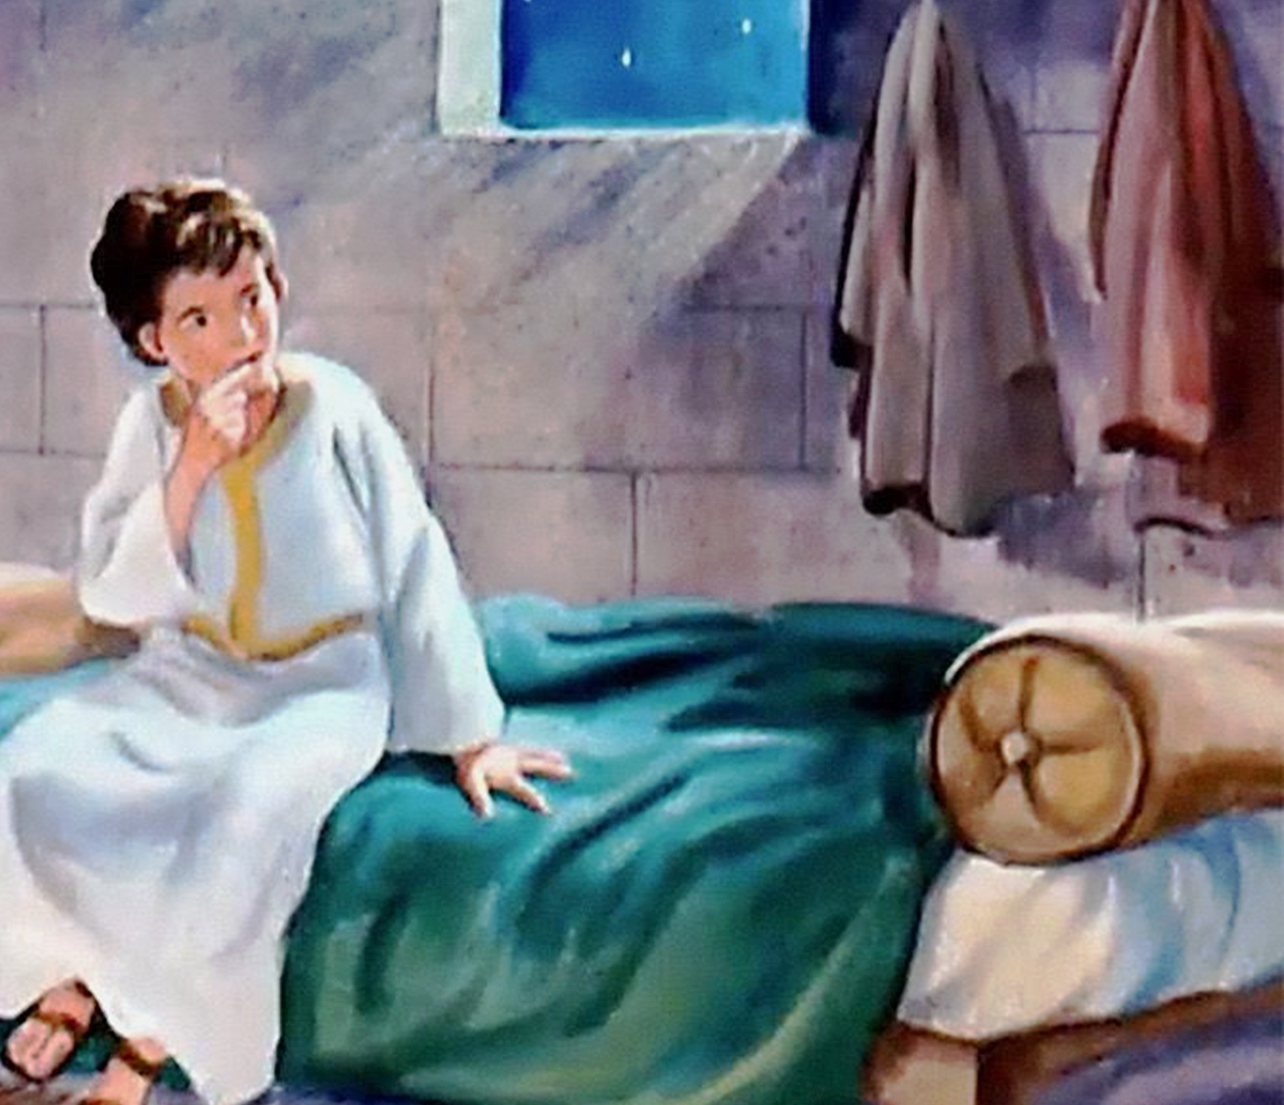
He that faithful in that which is least is faithful also in much.
The “child” - 12 years of age?
Samuel is faithfully serving God in a place where God is being mocked outright!

Slide 10
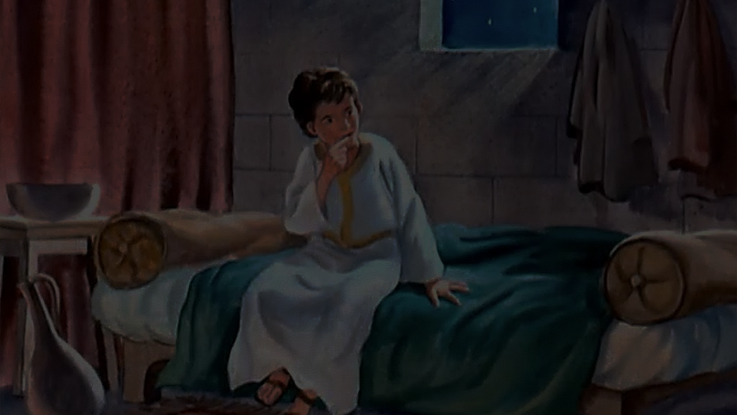
Luke 16:10 He that is faithful in that which is least is faithful also in much: and he that is unjust in the least is unjust also in much.
Hebrews 11:24-25 By faith Moses, when he was come to years, refused to be called the son of Pharaoh's daughter; 25 Choosing rather to suffer affliction with the people of God, than to enjoy the pleasures of sin for a season;

Slide 11
Eli the “elder” is not faithful.
Notice that Eli has his place too – a place of dysfunction and dereliction.
The lamp is out in the Temple (Tabernacle.)
Eli “Lofty” “God, most high”
He physically blind – picturing the
fact that he was spiritually blind.

Slide 12
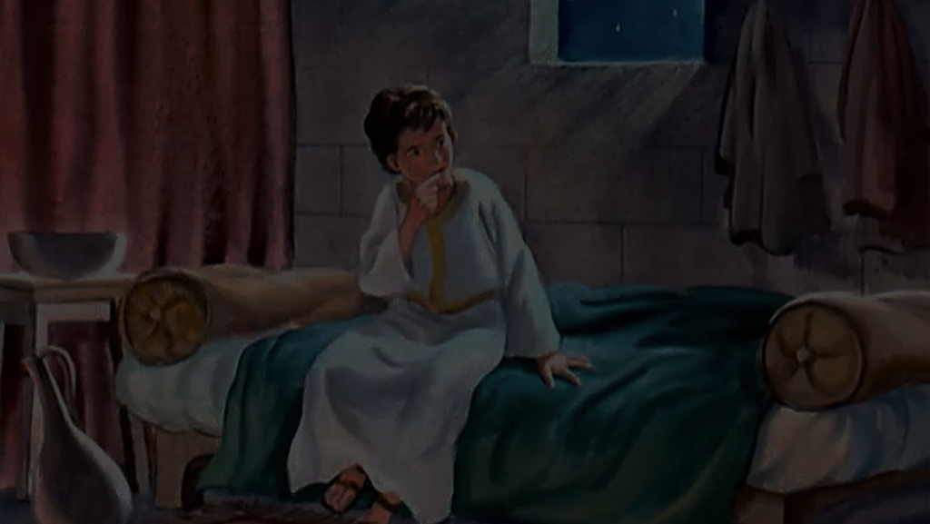
2 Corinthians 4:3-4 But if our gospel be hid, it is hid to them that are lost: 4 In whom the god of this world hath blinded the minds of them which believe not, lest the light of the glorious gospel of Christ, who is the image of God, should shine unto them.

Slide 13
Matthew 13:15 For this people's heart is waxed gross, and their ears are dull of hearing, and their eyes they have closed; lest at any time they should see with their eyes, and hear with their ears, and should understand with their heart, and should be converted, and I should heal them.

Slide 14
Psalm 119:130 The entrance of thy words giveth light; it giveth understanding unto the simple.

Slide 15
You cannot miss God’s call on your life.
The Lord calls to Samuel four times.
You can’t know the LORD without knowing His WORD!
When God is speaking, you CANNOT miss it!

Slide 16
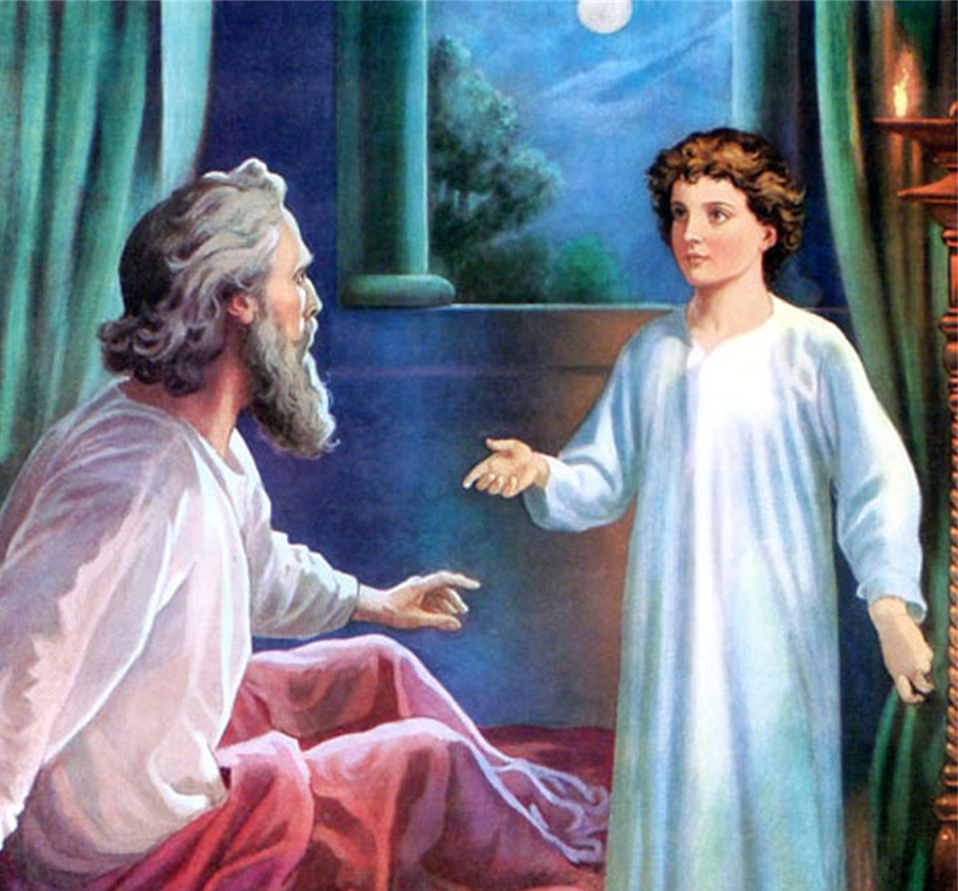

Slide 17
You cannot miss God’s judgment over sin.
Under the Law, the penalty of defiling the priesthood and rebelling against parental authority was death! Deut 17:12; 21:18-21

Slide 18
Numbers 15:30 But the soul that doeth ought presumptuously, whether he be born in the land, or a stranger, the same reproacheth the LORD; and that soul shall be cut off from among his people.
Hebrews 9:27 And as it is appointed unto men once to die, but after this the judgment:
Psalm 84:10b …I had rather be a doorkeeper in the house of my God, than to dwell in the tents of wickedness.

Slide 19
Samuel was a faithful
prophet from his start!
He held nothing back.

Slide 20
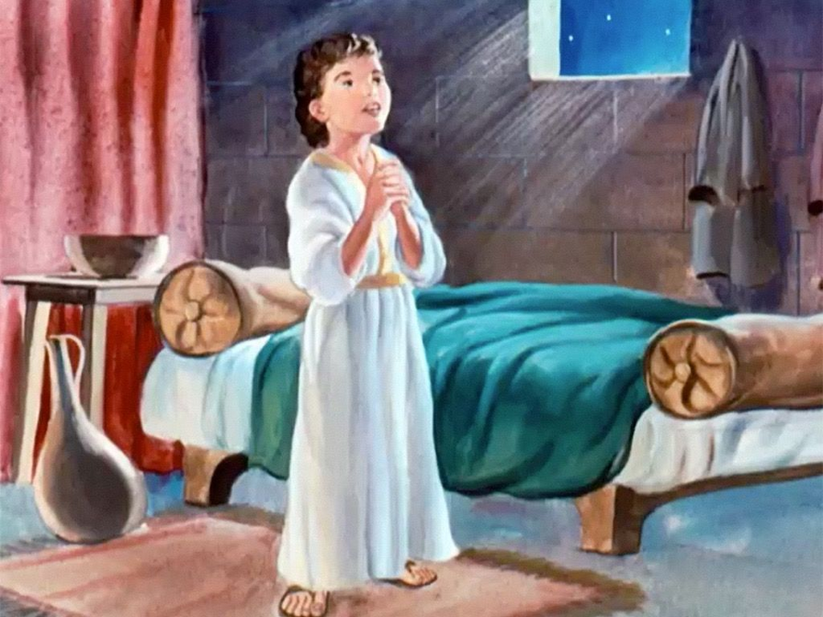
God confirms His call on your life through the structure He has you in.
Samuel learned God’s Word for himself.
(MBT – think “D1, D2, LFBI”)
God’s call on Samuel’s life was confirmed by God’s people. Vs 20-21

Slide 21
HEARING GOD
RECEIVING GOD’S WORD

